Slide 1
Pandas Techniques
Universal functions
Merging and joining datasets
A closer look at joins
Worked example

Slide 2
Section 1: Universal Functions
Overview
Ufuncs with a Series
Ufuncs with a DataFrame
Ufuncs with a DataFrame and Series

Slide 3
Overview
Earlier in the course we showed how to use universal functions with NumPy arrays
A universal function executes on all elements very efficiently
Much faster and cleaner than using an explicit loop
You can also use NumPy universal functions in Pandas
On a Series (or DataFrame column)
On a DataFrame
On a mixed operation with a DataFrame and Series
We show all these scenarios on the following slides

Slide 4
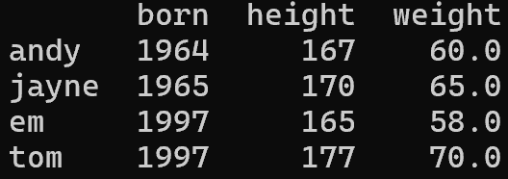
Ufuncs with a Series
You can use ufuncs with a Series object
E.g. a specific column in a DataFrame
stats = [
{'born': 1964, 'height': 167, 'weight': 60.0},
{'born': 1965, 'height': 170, 'weight': 65.0},
{'born': 1997, 'height': 165, 'weight': 58.0},
{'born': 1997, 'height': 177, 'weight': 70.0}
]
df = pd.DataFrame(stats, index=['andy', 'jayne', 'em', 'tom'])
# Perform ufunc on DataFrame column (i.e. Series), to convert height from cm to m.
df.height /= 100
# Perform ufunc on DataFrame column (i.e. Series), to create a new column.
df['weight_lbs'] = df['weight'] * 2.20462
# Also rename some columns, while we're at it.
df= df.rename(columns={'weight': 'weight_kg', 'height': 'height_m'})
print(df)
Ex01-UfuncSeries.py

Slide 5
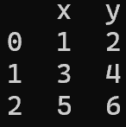
Ufuncs with a DataFrame
You can use ufuncs with a DataFrame object
Applies to all data in all rows and columns
coords = [
{'x': 1, 'y': 2}, {'x': 3, 'y': 4}, {'x': 5, 'y': 6}
]
df = pd.DataFrame(coords)
print('df + 2\n', df + 2)
print('df - 2\n', df - 2)
print('df * 2\n', df * 2)
print('df / 2\n', df / 2)
print('df // 2\n', df // 2)
print('df % 2\n', df % 2)
print('df ** 2\n', df ** 2)
print('sin(df)\n', np.sin(df))
print('cos(df)\n', np.cos(df))
print('tan(df)\n', np.tan(df))
print('sinh(df)\n', np.sinh(df))
print('cosh(df)\n', np.cosh(df))
print('tanh(df)\n', np.tanh(df))
Ex02-UfuncDataFrame.py

Slide 6

Ufuncs with a DataFrame and Series
You can use ufuncs with a DataFrame and a Series object
Ex03-UfuncDataFrameAndSeries.py
coords = [
{'x': 1, 'y': 2}, {'x': 3, 'y': 4}, {'x': 5, 'y': 6}
]
df = pd.DataFrame(coords)
s = pd.Series({'x': 100, 'y': 200})
print('Using operators')
print('df + s\n', df + s)
print('df - s\n', df - s)
print('df * s\n', df * s)
print('df / s\n', df / s)
print('df // s\n', df // s)
print('df % s\n', df % s)
print('df ** s\n', df ** s)
df
s

Slide 7
Section 2: Merging and Joining Datasets
Overview
One-to-one merges
Many-to-one merges
Many-to-many merges
Merging on an explicit common column name
Merging on explicit different column names
Merging on indexes

Slide 8
Overview
Pandas enables you to merge two DataFrame objects together very efficiently
pd.merge(dataframe1, dataframe2)
The way Pandas performs the merge operation depends on the relationship of rows in the two DataFrame objects
one-to-one
many-to-one
many-to-many
We show all these scenarios on the following slides

Slide 9
One-to-One Merges
In this example:
merge() detects that df1 and df2 both have a name column, and implicitly joins on these columns (it's a one-to-one join)
df1 = pd.DataFrame({
'name': ['Andy', 'Jayne', 'Em', 'Tom'],
'born': [1964, 1965, 1997, 1997]
})
df2 = pd.DataFrame({
'name': ['Andy', 'Jayne', 'Em', 'Tom'],
'height': [167, 170, 165, 177],
'weight': [60.0, 65.0, 58.0, 70.0]
})
# Do a one-to-one merge, based on the common 'name' column.
df3 = pd.merge(df1, df2)
print('\ndf3\n', df3)
df1
df2
name born
0 Andy 1964
1 Jayne 1965
2 Em 1997
3 Tom 1997
name height weight
0 Andy 167 60.0
1 Jayne 170 65.0
2 Em 165 58.0
3 Tom 177 70.0
Ex04-MergeOneToOne.py

Slide 10
Many-to-One Merges
In this example:
merge() detects that df1 and df2 both have an office column, and implicitly joins on these columns (it's a many-to-one join)
df1
df2
df1 = pd.DataFrame({
'name': ['Andy', 'Jayne', 'Em', 'Tom'],
'office': ['SWA', 'SWA', 'MCR', 'LON']
})
df2 = pd.DataFrame({
'office': ['SWA', 'LON', 'MCR', 'ABD'],
'city': ['Swansea', 'London', 'Manchester', 'Aberdeen'],
'region': ['Wales', 'S England', 'N England', 'Scotland']
})
# Do a many-to-one merge, based on the common 'office' column.
df3 = pd.merge(df1, df2)
print('\ndf3\n', df3)
name office
0 Andy SWA
1 Jayne SWA
2 Em MCR
3 Tom LON
office city region
0 SWA Swansea Wales
1 LON London S England
2 MCR Manchester N England
3 ABD Aberdeen Scotland
Ex05-MergeManyToOne.py

Slide 11
Many-to-Many Merges
In this example:
merge() detects that df1 and df2 both have a region column, and implicitly joins on these columns (it's a many-to-many join)
df1
df2
df1 = pd.DataFrame({
'name': ['Andy', 'Jayne', 'Em', 'Tom'],
'region': ['Wal', 'Wal', 'NEng', 'SEng']
})
df2 = pd.DataFrame({
'region': ['Wal', 'SEng', 'SEng', 'NEng', 'NEng'],
'city': ['Barry', 'Dover', 'Bath', 'York', 'Hull']
})
# Do a many-to-many merge, based on the common 'region' column.
df3 = pd.merge(df1, df2)
# Bonus bit: Add a new column that indicates the first occurrence of a region.
df3['first_occurrence_of_region'] = df3.groupby('region').cumcount() == 0
print('\ndf3\n', df3)
name region
0 Andy Wal
1 Jayne Wal
2 Em NEng
3 Tom SEng
region city
0 Wal Barry
1 SEng Dover
2 SEng Bath
3 NEng York
4 NEng Hull
Ex06-MergeManyToMany.py

Slide 12
Merging on an Explicit Common Column Name
In this example:
We tell merge() to merge on the common column called name
Why might this technique be useful?
df1 = pd.DataFrame({
'name': ['Andy', 'Jayne', 'Em', 'Tom'],
'born': [1964, 1965, 1997, 1997]
})
df2 = pd.DataFrame({
'name': ['Andy', 'Jayne', 'Em', 'Tom'],
'height': [167, 170, 165, 177],
'weight': [60.0, 65.0, 58.0, 70.0]
})
# Do a merge, explicitly telling it to merge on common 'name' column.
df3 = pd.merge(df1, df2, on='name')
print('\ndf3\n', df3)
df1
df2
name born
0 Andy 1964
1 Jayne 1965
2 Em 1997
3 Tom 1997
name height weight
0 Andy 167 60.0
1 Jayne 170 65.0
2 Em 165 58.0
3 Tom 177 70.0
Ex07-MergeOn.py

Slide 13
Merging on Explicit Different Column Names
In this example:
The column names we want to join on are different
So we must specify the name of the join column in both datasets
df1 = pd.DataFrame({
'name': ['Andy', 'Jayne', 'Em', 'Tom'],
'born': [1964, 1965, 1997, 1997]
})
df2 = pd.DataFrame({
'navn': ['Andy', 'Jayne', 'Em', 'Tom'],
'height': [167, 170, 165, 177],
'weight': [60.0, 65.0, 58.0, 70.0]
})
# Do a merge, explicitly telling it the columns to merge in left/right datasets.
df3 = pd.merge(df1, df2, left_on='name', right_on='navn')
print('\ndf3\n', df3)
# Same again, but drop the duplicate name/navn info.
df4 = pd.merge(df1, df2, left_on='name', right_on='navn').drop('navn', axis=1)
print('\ndf4\n', df4)
df1
df2
name born
0 Andy 1964
1 Jayne 1965
2 Em 1997
3 Tom 1997
navn height weight
0 Andy 167 60.0
1 Jayne 170 65.0
2 Em 165 58.0
3 Tom 177 70.0
Ex08-MergeLeftOnRightOn.py

Slide 14
Merging on Indexes (1 of 2)
In this example:
In df1, we join on the index
In df2, we join on the navn column
df1 = pd.DataFrame({
'name': ['Andy', 'Jayne', 'Em', 'Tom'],
'born': [1964, 1965, 1997, 1997]
})
df1 = df1.set_index('name')
df2 = pd.DataFrame({
'navn': ['Andy', 'Jayne', 'Em', 'Tom'],
'height': [167, 170, 165, 177],
'weight': [60.0, 65.0, 58.0, 70.0]
})
# Do a merge, telling it to use the index in the LHS dataset.
df3 = pd.merge(df1, df2, left_index=True, right_on='navn')
print('\ndf3\n', df3)
df1
df2
born
name
Andy 1964
Jayne 1965
Em 1997
Tom 1997
navn height weight
0 Andy 167 60.0
1 Jayne 170 65.0
2 Em 165 58.0
3 Tom 177 70.0
Ex09a-MergeLeftIndex.py
Also see Ex09b-MergeRightIndex.py

Slide 15
Merging on Indexes (2 of 2)
In this example, both datasets are joined by index
df1 = pd.DataFrame({
'name': ['Andy', 'Jayne', 'Em', 'Tom'],
'born': [1964, 1965, 1997, 1997]
})
df1 = df1.set_index('name')
df2 = pd.DataFrame({
'navn': ['Andy', 'Jayne', 'Em', 'Tom'],
'height': [167, 170, 165, 177],
'weight': [60.0, 65.0, 58.0, 70.0]
})
df2 = df2.set_index('navn')
# Do a merge, telling it to use the index in both LHS and RHS datasets.
df3 = pd.merge(df1, df2, left_index=True, right_index=True)
df3.index.name = 'nom'
print('\ndf3\n', df3)
# Equivalently, call join(), which implicitly joins the datasets by index.
df4 = df1.join(df2)
df4.index.name = 'enw'
print('\ndf4\n', df4)
df1
df2
born
name
Andy 1964
Jayne 1965
Em 1997
Tom 1997
height weight
navn
Andy 167 60.0
Jayne 170 65.0
Em 165 58.0
Tom 177 70.0
Ex09c-MergeLeftIndexRightIndex.py

Slide 16
Section 3: A Closer Look at Joins
Overview
Inner join
Outer join
Left join
Right join

Slide 17
Overview
As we've seen, merge() and join() enable us to join data from two datasets
E.g. based on a common column name in the two datasets
What if one dataset has some rows that aren't matched in the other dataset - what should happen then?
There are 4 possibilities
Inner join - Only return rows that match in both datasets
Outer join - Return all rows, with blanks for the missing bits
Left join - Return all the rows from left-hand-side dataset
Right join - Return all the rows from right-hand-side dataset

Slide 18
Inner Join
Returns rows that are matched in both datasets:
df1 = pd.DataFrame({
'name': ['Andy', 'Jayne', 'Em', 'Tom'],
'salary': [10000, 20000, 30000, 40000]
})
df1 = df1.set_index('name')
df2 = pd.DataFrame({
'name': ['Andy', 'Jayne', 'Gareth'],
'level': ['Medium', 'Expert', 'Genius'],
'years': [3, 5, 20]
})
df2 = df2.set_index('name')
# Do an inner join implicitly (i.e. inner join is the default).
df3 = pd.merge(df1, df2, left_index=True, right_index=True)
df3.index.name = 'name'
print('\ndf3\n', df3)
# Do an inner join explicitly (by setting how='inner').
df4 = pd.merge(df1, df2, left_index=True, right_index=True, how='inner')
df4.index.name = 'name'
print('\ndf4\n', df4)
Ex10-InnerJoin.py
df1
df2
salary
name
Andy 10000
Jayne 20000
Em 30000
Tom 40000
level years
name
Andy Medium 3
Jayne Expert 5
Gareth Genius 20

Slide 19
Outer Join
Returns all rows, with blanks for the missing bits:
df1 = pd.DataFrame({
'name': ['Andy', 'Jayne', 'Em', 'Tom'],
'salary': [10000, 20000, 30000, 40000]
})
df1 = df1.set_index('name')
df2 = pd.DataFrame({
'name': ['Andy', 'Jayne', 'Gareth'],
'level': ['Medium', 'Expert', 'Genius'],
'years': [3, 5, 20]
})
df2 = df2.set_index('name')
# Do an outer join (by setting how='outer').
df3 = pd.merge(df1, df2, left_index=True, right_index=True, how='outer')
df3.index.name = 'name'
print('\ndf3\n', df3)
Ex11-OuterJoin.py
df1
df2
salary
name
Andy 10000
Jayne 20000
Em 30000
Tom 40000
level years
name
Andy Medium 3
Jayne Expert 5
Gareth Genius 20

Slide 20
Left Join
Returns all the rows from the left-hand-side dataset:
df1 = pd.DataFrame({
'name': ['Andy', 'Jayne', 'Em', 'Tom'],
'salary': [10000, 20000, 30000, 40000]
})
df1 = df1.set_index('name')
df2 = pd.DataFrame({
'name': ['Andy', 'Jayne', 'Gareth'],
'level': ['Medium', 'Expert', 'Genius'],
'years': [3, 5, 20]
})
df2 = df2.set_index('name')
# Do a left join (by setting how='left').
df3 = pd.merge(df1, df2, left_index=True, right_index=True, how='left')
df3.index.name = 'name'
print('\ndf3\n', df3)
Ex12-LeftJoin.py
df1
df2
salary
name
Andy 10000
Jayne 20000
Em 30000
Tom 40000
level years
name
Andy Medium 3
Jayne Expert 5
Gareth Genius 20

Slide 21
Right Join
Returns all the rows from the right-hand-side dataset:
df1 = pd.DataFrame({
'name': ['Andy', 'Jayne', 'Em', 'Tom'],
'salary': [10000, 20000, 30000, 40000]
})
df1 = df1.set_index('name')
df2 = pd.DataFrame({
'name': ['Andy', 'Jayne', 'Gareth'],
'level': ['Medium', 'Expert', 'Genius'],
'years': [3, 5, 20]
})
df2 = df2.set_index('name')
# Do a right join (by setting how='right').
df3 = pd.merge(df1, df2, left_index=True, right_index=True, how='right')
df3.index.name = 'name'
print('\ndf3\n', df3)
Ex13-RightJoin.py
df1
df2
salary
name
Andy 10000
Jayne 20000
Em 30000
Tom 40000
level years
name
Andy Medium 3
Jayne Expert 5
Gareth Genius 20

Slide 22
Section 4: Worked Example
Sample data
Processing the data

Slide 23
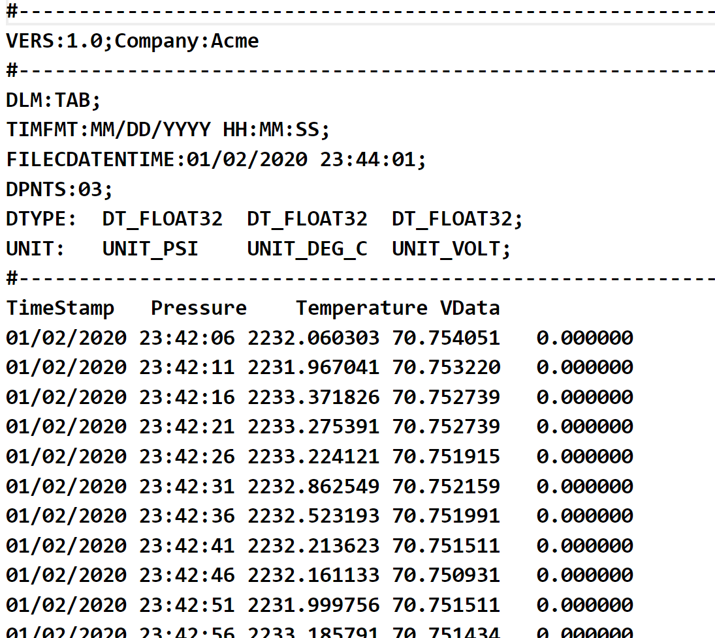
Sample Data
See the WorkedExample folder, which contains a text file of data collected over a period of time
The data was collected mostly at 5s intervals, but sometimes at 1s intervals (or other intervals)
Pressures.txt

Slide 24
Processing the Data
We've written a Python app that splits the data into 3 Excel spreadsheets containing:
Rows where there's a 5s interval
Rows where there's a 1s interval
Rows where there's some other interval
See the full code in ProcessPressures.py

Slide 25
Summary
Universal functions
Merging and joining datasets
A closer look at joins
Worked example

